Slide 1



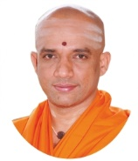
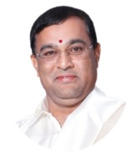
|| Jai Sri Gurudev ||
Sri Adichunchanagiri Shikshana Trust®
SJB INSTITUTE OF TECHNOLOGY
Department of Electronics & Communication Engineering
Phase-1 - Mini-Project (18ECMP68) Review Presentation on
POTATO LEAF DISEASE DETECTION USING DEEP LEARNING
Under the guidance of
Mrs. Pushpalatha G
Assistant Professor
Dept. of ECE, SJBIT
Presented By
Pavan Kumar Yadav K 1JB19EC064
Sabari Krishnan A 1JB19EC078

Slide 2
CONTENTS
Abstract
Introduction
Motivation and Challenges
Literature Survey
Problem Description and Objective
Proposed Methodology
Tools Used
Applications
References

Slide 3
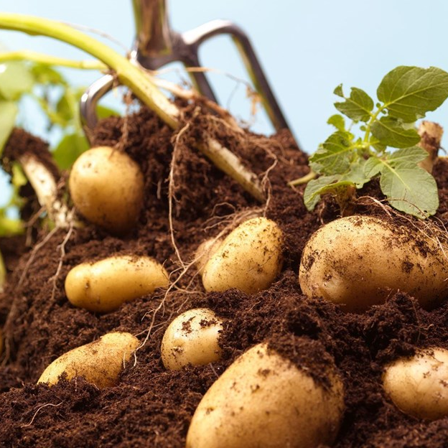
ABSTRACT
Potatoes are rich in nutrients, most notably vitamins C and B6 and the minerals, potassium, magnesium, and iron .
Besides being a popular staple food in Indonesia, potatoes are the fourth most consumed vegetable crop in the world.
potatoes are lost every year owing to diseases and pests globally by 32% and in India by 15.75%
In this project, we are going to use – Deep Learning to diagnose Potato plant diseases and suggest suitable treatment for them

Slide 4
INTRODUCTION
Farmers who grow potatoes suffer from serious financial standpoint losses each year which cause several diseases that affect potato plants.
The most frequent potato disease which occur are Early Blight and Late Blight
Early blight is caused by fungus and late blight is caused by specific micro-organisms
The treatments for early blight and late blight are a little different so it’s important that you accurately identify what kind of disease is there in that potato plant.

Slide 5
Motivation
There is need for developing technique such as automatic plant disease detection and classification using leaf image processing techniques
This will prove as a useful technique for farmers and will alert them at the right time before spreading of the disease over large area
Philanthropy - The fulfilling feeling of giving back and contributing to society is unparalleled

Slide 6
LITERATURE REVIEW
SL.No | AUTHOR NAME | YEAR | TITLE OF PAPER | INFERENCE
1 | S.A. Ali, N. Sulaiman, A. Mustapha and N. Mustapha,.” | 2009 | K-Means Clustering to Improve the Accuracy of Decision Tree Response Classification | Decision tree, re-tagging response classes
2 | Krizhevsky, A.; Sutskever, I.; Hinton, G | 2012 | ImageNet classification with deep convolutional networks | ImageNet
3 | Islam, M.; Dinh, A.; Wahid, K.; Bhowmik, P. | 2017 | Detection of potato diseases using image segmentation and multiclass support vector machine | SVMs
4 | Sambasivam, G.; Opiyo, G.D | 2020 | A predictive machine learning application in agriculture: Cassava disease detection and classification with imbalanced dataset using convolutional neural networks | CNN
5 | Zhang, Y.; Song, C.; Zhang | 2020 | Deep learning-based object detection improvement for tomato disease | RCNN
6 | Khalifa, N.E.M.; Taha, M.H.N.; Abou El-Maged, L.M.; Hassanien, A.E | 2021 | Artificial Intelligence in Potato Leaf Disease Classification: A Deep Learning Approach. In Machine Learning and Big Data Analytics Paradigms: Analysis, Applications and Challenges | ML, DL, BIG Data

Slide 7
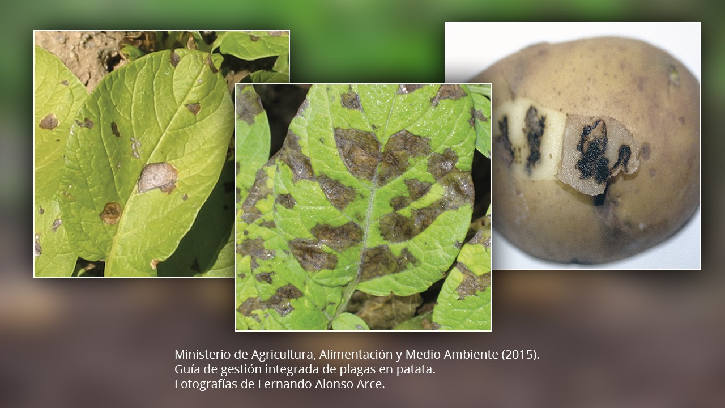
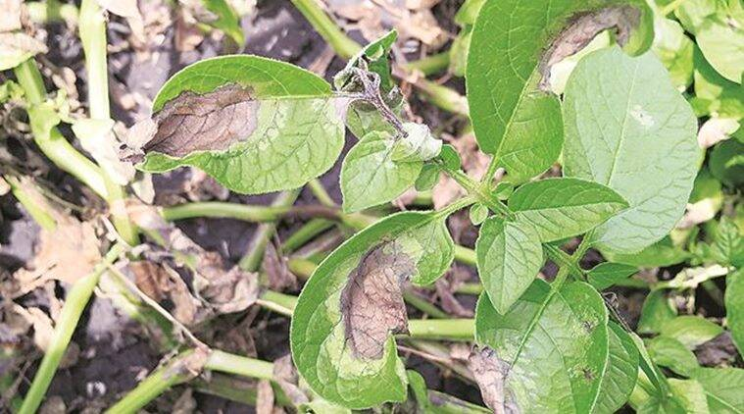
LEAF DISEASES
EARLY BLIGHT:-
LATE BLIGHT:-

Slide 8
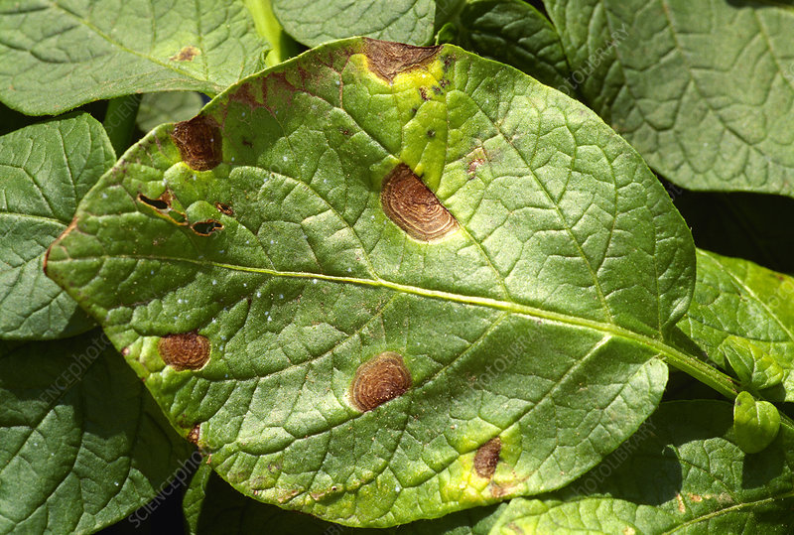
EARLY BLIGHT
Early blight of potato is caused by the fungal pathogen Alternaria solani
The disease affects leaves, stems and tubers and can reduce yield.
Symptoms appear first on the oldest foliage. Affected leaves develop circular to angular dark brown lesions 0.12 to 0.16 inch (3–4 mm) in diameter
Infection occurs when spores of the fungus come in contact with susceptible leaves and sufficient free moisture is present.
Early blight can be minimized by maintaining optimum growing conditions, including proper fertilization, irrigation, and management of other pests.
Small dark spots on the lower and older leaves of the plant(yellow ring over the spots is present)
symptoms

Slide 9
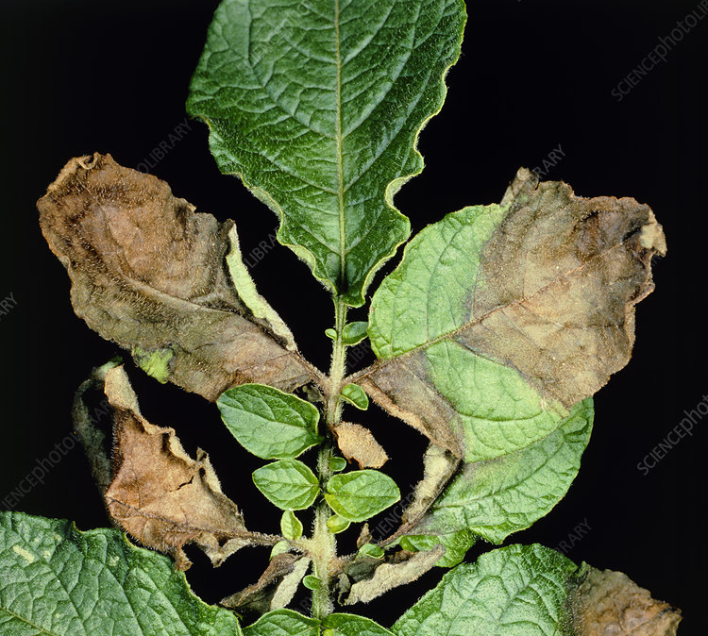
LATE BLIGHT
caused by the water mold Phytophthora infestan
The disease occurs in humid regions with temperatures ranging between
4 and 29 °C
When plants have become infected, lesions (round or irregularly shaped areas that range in colour from dark green to purplish black and resemble frost injury) appear on the leaves, petioles, and stems
The disease can be managed with a timely application of fungicide, though epidemics can occur rapidly once crops are infected.
Dark and irregular spots with drenching appearance(yellow ring over the spots not present)
symptoms

Slide 10
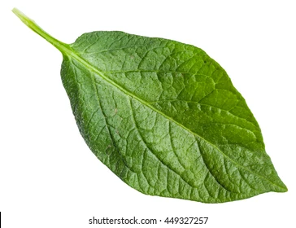
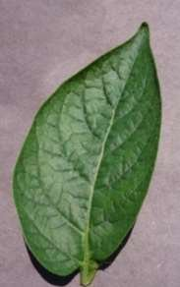

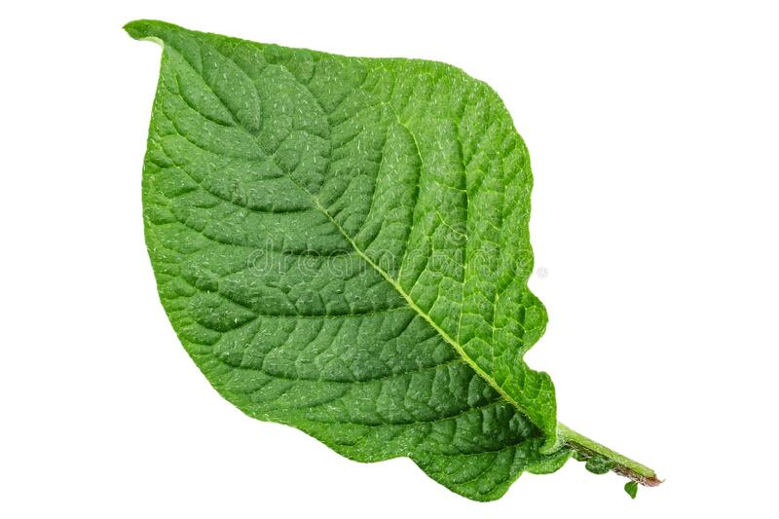
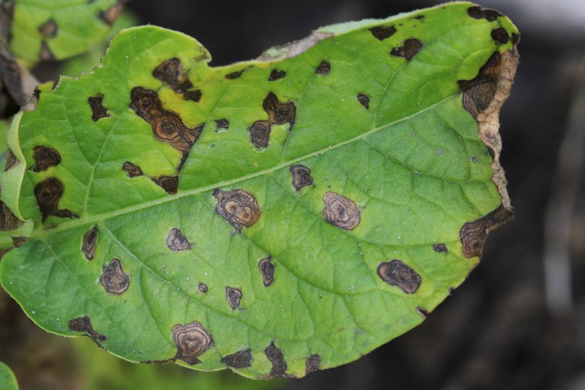
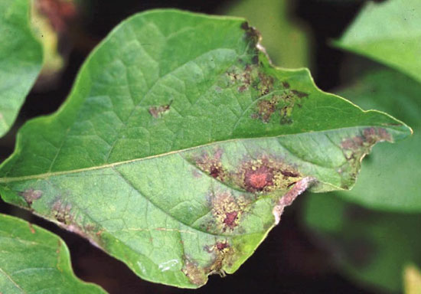

Basic Model
Model building
Data cleaning and pre processing
Data sets
TF dataset
CNN
Trained model
Data augmentation
TF server
(run on the trained model function)

Slide 11






Contd….
QUANTISATION
It is a way to reduce of the size of the model such that it occupies less memory
Speed of the process becomes more faster
Quantisation
Exported float model
shrinked
Format
(TF LITE)
These functon help the mobile application, made
Using
React native
GC func are written accordingly
TF lite model deployed to google cloud

Slide 12
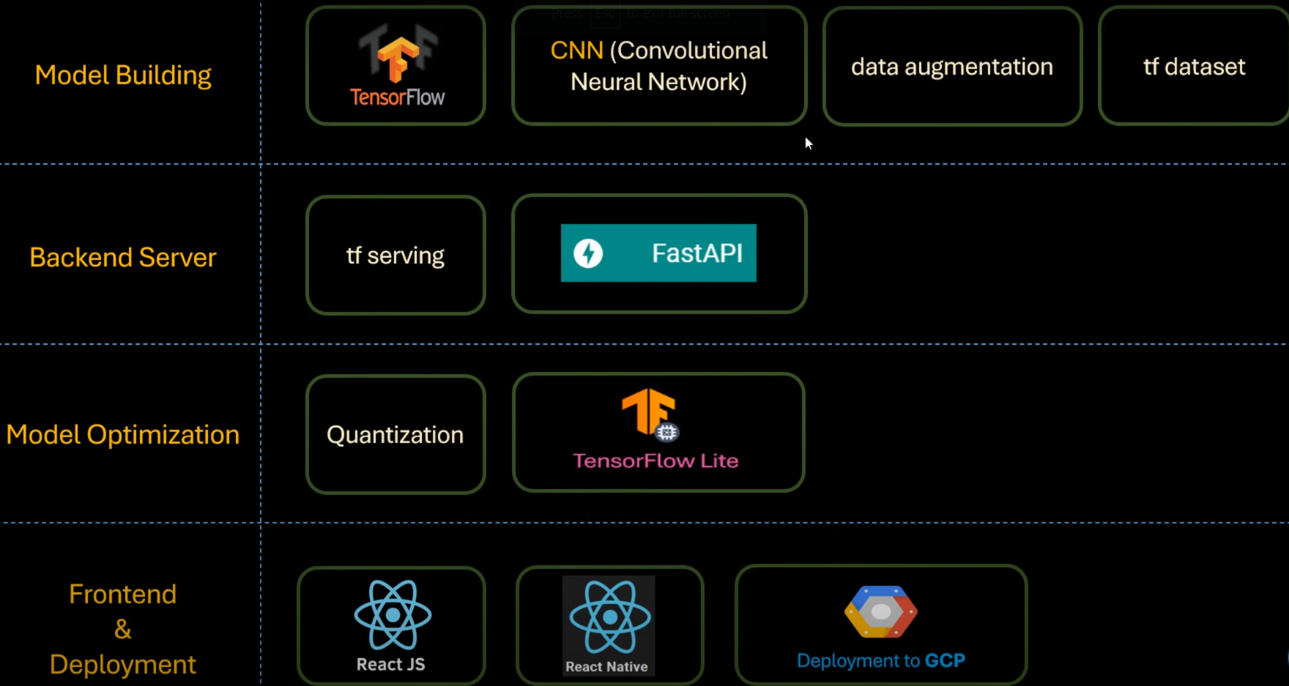
Skills used

Slide 13
APPLICATIONS
Document classification
Identifying crime localities in a city
Customer segmentation
Fantasy league player stat analysis
Agriculture
Understanding and managing financial risk
Trading futures
Credit rating
Loan management
Bank customer profiling
Medicine

Slide 14
REFERENCES
S.A. Ali, N. Sulaiman, A. Mustapha and N. Mustapha,.” K-Means Clustering to Improve the Accuracy of Decision Tree Response Classification”. Information Technology Journal ,2009
Krizhevsky, A.; Sutskever, I.; Hinton, G. “: ImageNet classification with deep convolutional networks”. In Proceedings of the Conference Neural Information Processing Systems (NIPS), Lake Tahoe, NV, USA, 3–6 (AlexNet, Overfeat AlexNetOWTBn),December 2012
Islam, M.; Dinh, A.; Wahid, K.; Bhowmik, P. “ Detection of potato diseases using image segmentation and multiclass support vector machine”. In Proceedings of the 2017 IEEE 30th Canadian conference on electrical and computer engineering (CCECE), Windsor, ON, Canada, 30 April–3 May 2017
Sambasivam, G.; Opiyo, G.D. “A predictive machine learning application in agriculture: Cassava disease detection and classification
with imbalanced dataset using convolutional neural networks”. Egypt. Inform. J. 2020(CNN)
5. Zhang, Y.; Song, C.; Zhang, D. “Deep learning-based object detection improvement for tomato disease”. IEEE Access 2020(RCNN)
Khalifa, N.E.M.; Taha, M.H.N.; Abou El-Maged, L.M.; Hassanien, A.E. “Artificial Intelligence in Potato Leaf Disease Classification: A Deep
Learning Approach. In Machine Learning and Big Data Analytics Paradigms: Analysis, Applications and Challenges”; Springer:
Berlin/Heidelberg, Germany, 2021

Slide 15


